Slide 1
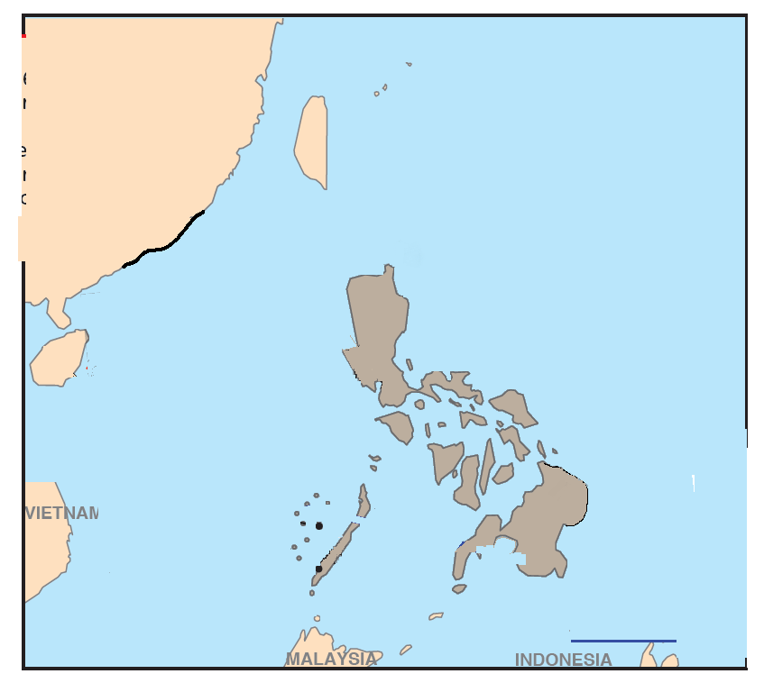
Submarines
Naval Ships
Ground Aircraft beyond visual range
(ground based) (SU-30MK2)
Destroyer equipped with
AD with range 300-400 km
Spy-satellites
ISR

